Slide 1




ML @ ICL
Episode 16
Deep learning frameworks

Slide 2
Previously on deep learning...

Slide 3
Feature extraction
Feature
Extractor
(manual)
Classifier
Ɵ1~{W,b}
X
Prediction

Slide 4

Features would tune to your problem automatically!

Slide 5
Simple neural network
Linear
model
σ(h)
Linear
model
σ(h)
X
Prediction
Trains with stochastic gradient descent!
or momentum/rmsprop/adam/...

Slide 6
Connectionist phrasebook
Layer – a building block for NNs :
    “Dense layer”: f(x) = Wx+b
    “Nonlinearity layer”: f(x) = σ(x)
    Input layer, output layer
    A few more we gonna cover later
Activation – layer output
    i.e. some intermediate signal in the NN
Backpropagation – a fancy word for “chain rule”

Slide 7
Backpropagation
TL;DR: backprop = chain rule*

Slide 8
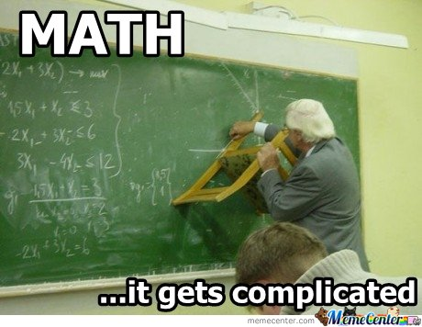
Backpropagation
TL;DR: backprop = chain rule*
* g and x can be vectors/vectors/tensors

Slide 9
Backpropagation
linear
|h|=64
W1,b1
σ(h)
linear
|h|=1
W1,b1
σ(h)
X
Prediction
Y
Loss

Slide 10
Matrix derivatives we used
Works for any kind of x
(scalar, vector, matrix, tensor)

Slide 11
Matrix derivatives we used
Works for any kind of x
(scalar, vector, matrix, tensor)

Slide 12
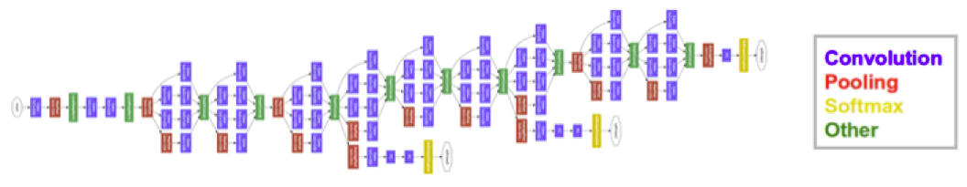
And now let's differentiate
5+ types of layers
each with different dimensions
parallel branches with independent losses
several nonlinearities

Slide 13

And now let's differentiate
5+ types of layers
each with different dimensions
parallel branches with independent losses
several nonlinearities

Slide 14
Deep learning frameworks
Dream deep learning framework
    Automatic gradients
    Pre-implemented popular “layers”
    Optimized computation (GPU & multi-CPU)

Slide 15
Deep learning frameworks
Core idea: helps you define and train neural nets
Keras, Lasagne, Slim
& many more
High-level
Caffe, Theano, TF, Torch,...
Low-level libraries
CUDNN
Low-level
CUDAC++, CUDA*
Low-level
CUDAC++, CUDA*
Hardware
(CPU/GPU/TPU/FPGA)

Slide 16
Deep learning frameworks
Core idea: helps you define and train neural nets
We'll spend next K slides here
Keras, Lasagne, Slim
& many more
High-level
Caffe, Theano, TF, Torch,...
Low-level libraries
CUDNN
Low-level
CUDAC++, CUDA*
Low-level
CUDAC++, CUDA*
Hardware
(CPU/GPU/TPU/FPGA)

Slide 17
Deep learning frameworks
Layer-based frameworks:
  Same idea as in our hand-made neural net

Slide 18
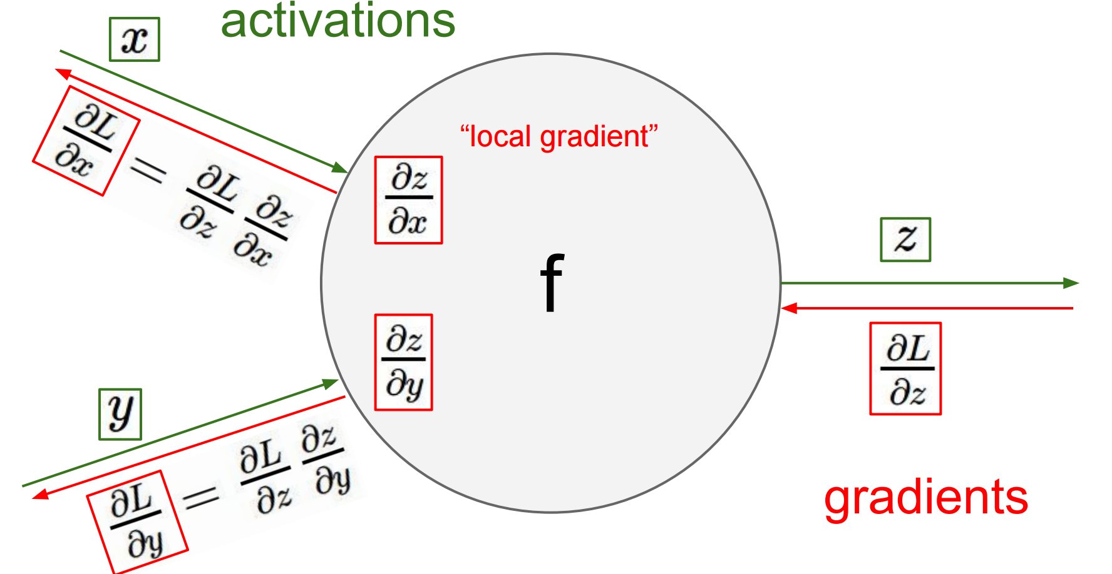

Deep learning frameworks
Layer-based frameworks:
  Same idea as in our hand-made neural net
  this one - http://bit.ly/2w9kAHm
Layer

Slide 19

Deep learning frameworks
name: "LeNet"
layer {
name: "conv1"
type: "Convolution"
bottom: "data"
top: "conv1"
param {lr_mult: 1}
param {lr_mult: 2}
convolution_param {
num_output: 20
kernel_size: 5
stride: 1
weight_filler {
type: "xavier"
}}}
….
You define model in config file
by stacking layers.
Then train like this:
caffe train -solver examples/mnist/lenet_solver.prototxt
130 lines

Slide 20
Deep learning frameworks
name: "LeNet"
layer {
name: "conv1"
type: "Convolution"
bottom: "data"
top: "conv1"
param {lr_mult: 1}
param {lr_mult: 2}
convolution_param {
num_output: 20
kernel_size: 5
stride: 1
weight_filler {
type: "xavier"
}}}
….
+ Easy to deploy (C++)
+ A lot of pre-trained models
(model zoo)
- Model as protobuf
- Hard to build new layers
- Hard to debug
Industry standard
for computer vision
130 lines

Slide 21
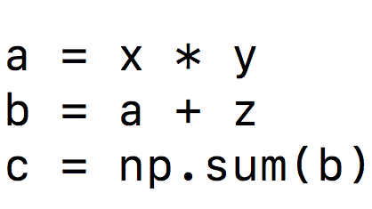
Symbolic graphs
What will your CPU do
when you write this?
This many further slides taken from Ars Ashukha @deepbayes2017

Slide 22
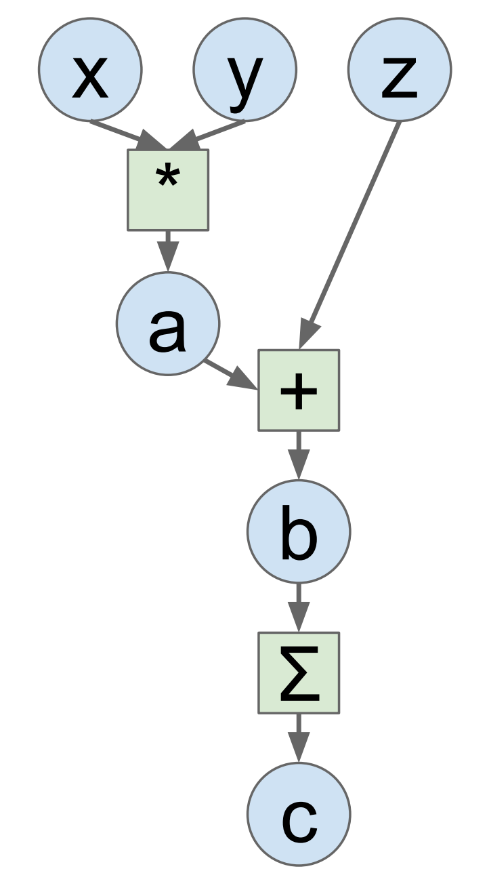
Symbolic graphs
Idea: let's define
this graph explicitly!
This many further slides taken from Ars Ashukha @deepbayes2017

Slide 23
Symbolic graphs
+ Automatic gradients!
+ Easy to build new layers
+ We can optimize the Graph
- Graph is static during training
- Need time to compile/optimize
- Hard to debug
Grads
This many further slides taken from Ars Ashukha @deepbayes2017

Slide 24


60 seconds of holywar
and
Graph optimization
Numpy-like interface
Great for RNNs
Inconvenient randomness
Worse multi-gpu support
Yet another argument
Easier to deploy
Graph visualization
Google! (and hype)
Worse optimization
Sessions, graphs
Yet another argument

Slide 25
60 seconds of coding
Note to self: start coding!

Slide 26
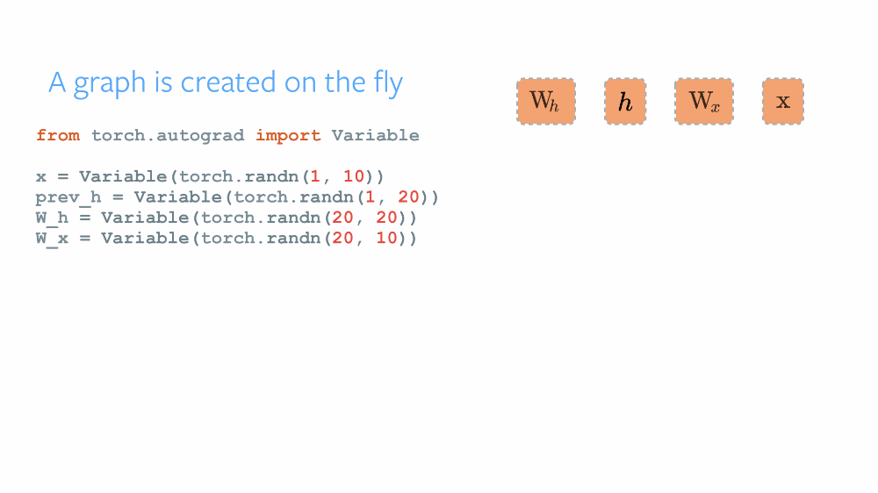
Dynamic graphs
Chainer, DyNet, Pytorch

Slide 27


Dynamic graphs
Chainer, DyNet, Pytorch
+ Can change graph on the fly
+ Can get value of any tensor at any time
(easy debugging)
- Hard to optimize graphs
(especially large graphs)
- Still early development
Researchers love them!

Slide 28
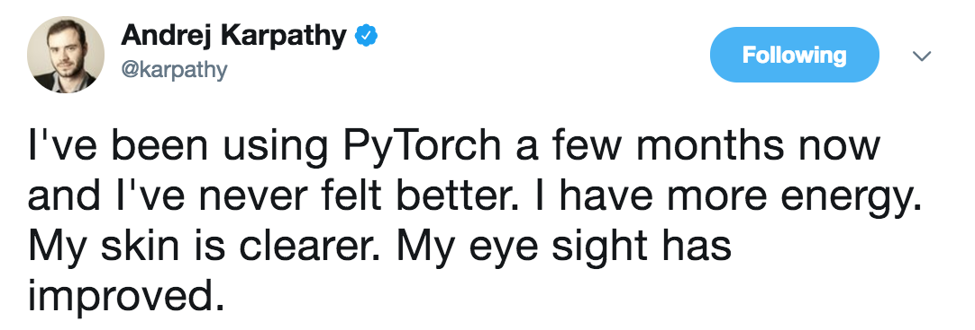
Dynamic graphs
Researchers love them!

Slide 29

We gonna be using pytorch...

